Slide 2

JavaScript

Slide 3
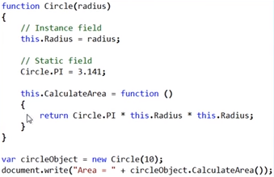
Static Members
In an object oriented programming language, classes can have static members, that is static methods and static fields.
PI is a static field and _radius is an instance field.
Points to remember
Define a static memeber using the name of the constructor function.
To invoke a static memeber use the name of the constructor function.
To invoke an instance memeber use the instance of the constructor function.

Slide 4
Properties
Properties are the values associated with a JavaScript object.
A JavaScript object is a collection of unordered properties.
Properties can usually be changed, added, and deleted, but some are read only.

Slide 5
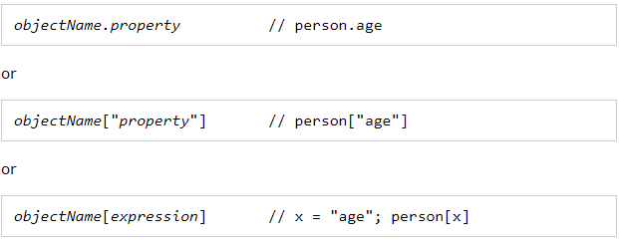
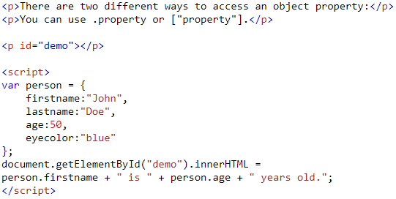

Accessing JavaScript Properties
The syntax for accessing the property of an object is:
Example:
Output

Slide 6
Prototypes
All JavaScript objects inherit the properties and methods from their prototype.
Objects created using an object literal, or with new Object(), inherit from a prototype called Object.prototype.
Objects created with new Date() inherit the Date.prototype.
The Object.prototype is on the top of the prototype chain.
All JavaScript objects (Date, Array, RegExp, Function, ....) inherit from the Object.prototype.

Slide 7
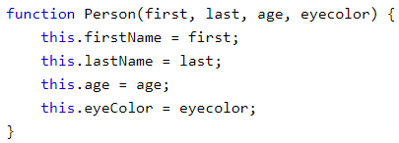
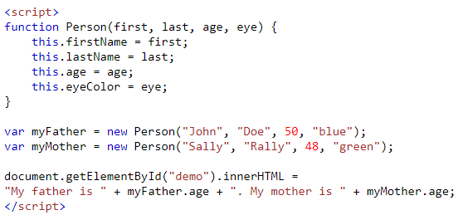
Creating a Prototype
The standard way to create an object prototype is to use an object constructor function:
Example
With a constructor function, we can use the new keyword to create new objects from the same prototype:
Output

Slide 8
Inheritance
Object oriented programming languages support inheritance. Since JavaScript is also an object oriented programming language, it supports inheritance.
In OOP languages like C# and Java to implement inheritance, a class inherits from another class. In JavaScript, we don't have the concept of classess, so inheritance in JavaScript is prototype-based. This means to implement inheritance in JavaScript, an object inherits from another object.

Slide 9
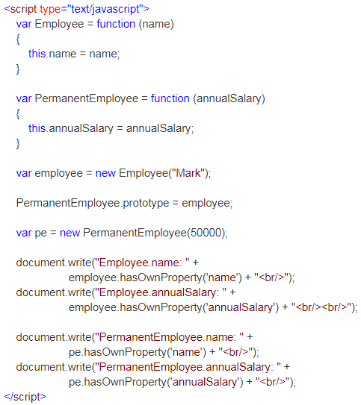
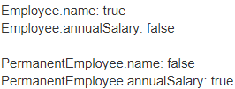
Example of Inheritance
Use hasOwnProperty() method to determine if a property is defined on the actual object or it's prototype. Here is an example.
Output:

Slide 10
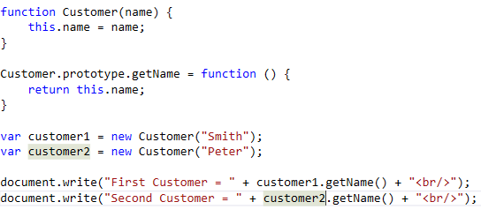
Overidding
One of the advantages of using prototype property to add functions is the it enables us to override an existing function if required.

Slide 11
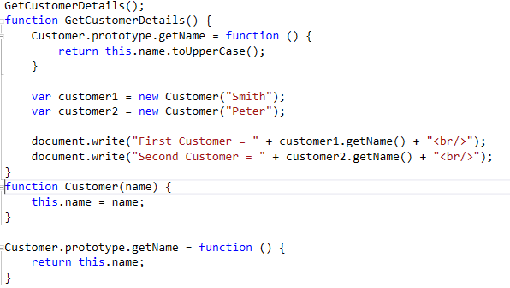
Override the Customer

Slide 12
Polymorphism
Polymorphism in Object-Oriented Programming is the ability to create a variable, a function, or an object that has more than one form.
The primary usage of Polymorphism in Object-Oriented Programming is the ability of objects belonging to different types to respond to methods, fields, or property calls of the same name, each one according to an appropriate type-specific behaviour.

Slide 13
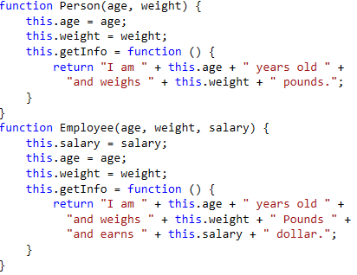
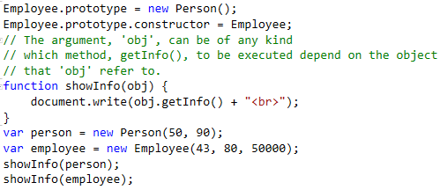
Example of Polymorphism

Slide 14
Abstract Class
Abstract classes are classes that contain one or more abstract methods. An abstract method is a method that is declared, but contains no implementation. Abstract classes may not be instantiated, and require subclasses to provide implementations for the abstract methods.

Slide 15
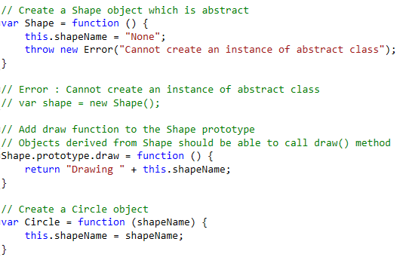
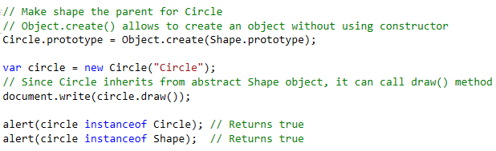
Example Code

Slide 16
Strict Mode
The "use strict" directive is new in JavaScript 1.8.5 (ECMAScript version 5).
It is not a statement, but a literal expression, ignored by earlier versions of JavaScript.
The purpose of "use strict" is to indicate that the code should be executed in "strict mode".
With strict mode, you can not, for example, use undeclared variables.

Slide 17
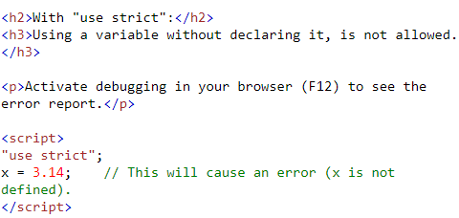
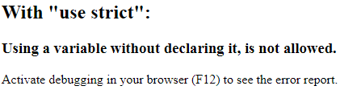
Declaring Strict Mode
Strict mode is declared by adding "use strict"; to the beginning of a script or a function.
Declared at the beginning of a script, it has global scope (all code in the script will execute in strict mode):
Example Output

Slide 18
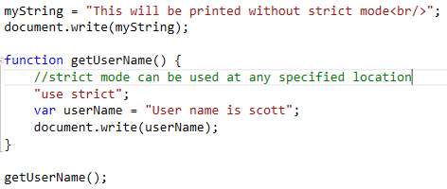
How to enforce JavaScript strictness in a specfic function:
Just add “use strict” statement in the function as shown below. In this example, strictness is enforced only in getUserName().

Slide 19
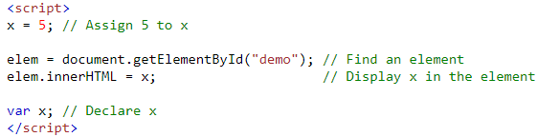
Self-Hosting
Hoisting is JavaScript's default behavior of moving declarations to the top.
In JavaScript, a variable can be declared after it has been used.
In other words; a variable can be used before it has been declared.
Example Output
5

Slide 20
Promise
A Promise is a proxy for a value not necessarily known when the promise is created. It allows you to associate handlers with an asynchronous action's eventual success value or failure reason. This lets asynchronous methods return values like synchronous methods: instead of immediately returning the final value, the asynchronous method returns a promise to supply the value at some point in the future.
A Promise is in one of these states:
pending: initial state, neither fulfilled nor rejected.
fulfilled: meaning that the operation completed successfully.
rejected: meaning that the operation failed.

Slide 21
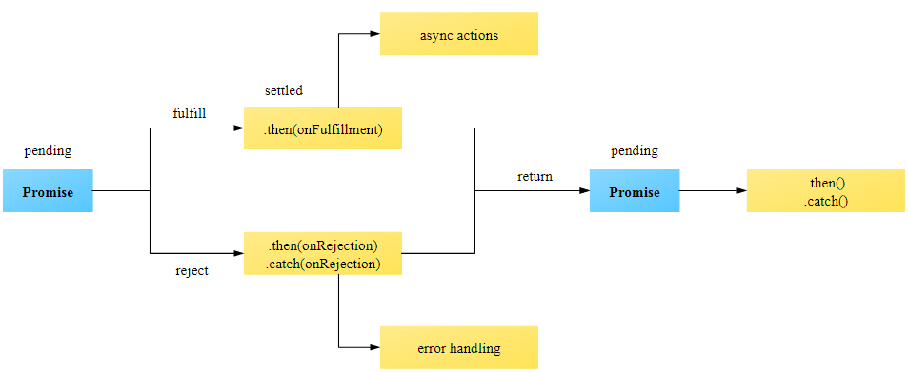
Promise
As the Promise.prototype.then() and Promise.prototype.catch() methods return promises, they can be chained.

Slide 22
Properties & Methods
Promise.length
Length property whose value is always 1 (number of constructor arguments).
Promise.prototype
Represents the prototype for the Promise constructor.
Methods
Promise.prototype.catch(onRejected)
Appends a rejection handler callback to the promise, and returns a new promise resolving to the return value of the callback if it is called, or to its original fulfillment value if the promise is instead fulfilled.
Promise.prototype.then(onFulfilled, onRejected)
Appends fulfillment and rejection handlers to the promise, and returns a new promise resolving to the return value of the called handler, or to its original settled value if the promise was not handled (i.e. if the relevant handler onFulfilled or onRejected is not a function).
Promise.prototype.finally(onFinally)
Appends a handler to the promise, and returns a new promise which is resolved when the original promise is resolved. The handler is called when the promise is settled, whether fulfilled or rejected.

Slide 23
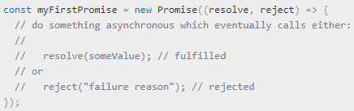
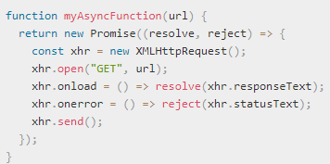
Creating a Promise
A Promise object is created using the new keyword and its constructor. This constructor takes as its argument a function, called the "executor function". This function should take two functions as parameters. The first of these functions (resolve) is called when the asynchronous task completes successfully and returns the results of the task as a value. The second (reject) is called when the task fails, and returns the reason for failure, which is typically an error object.
To provide a function with promise functionality, simply have it return a promise:

Slide 24
THANK YOU

